Slide 1
Machine Learning Foundations and Applications
Jiaul Paik

Slide 2
Topics
Batch Normalization
Regularization

Slide 3
Batch Normalization

Slide 4
Internal Covariance Shift
Each layer of a neural network has inputs with a corresponding distribution
It generally depends on
the randomness in the parameter initialization and
the randomness in the input data.
These effect on the internal layers during training is called internal covariate shift.

Slide 5
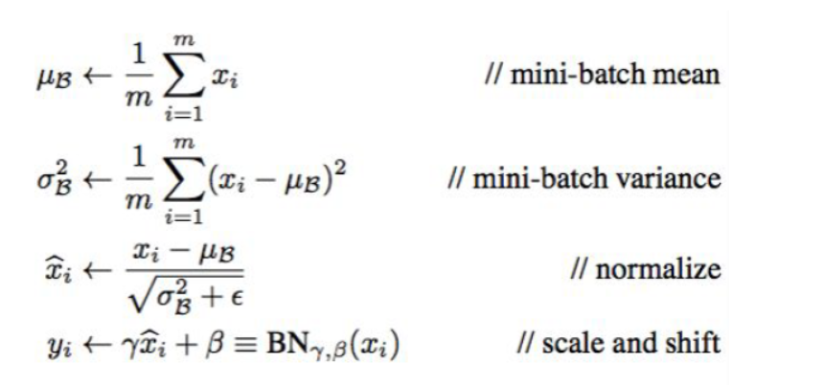
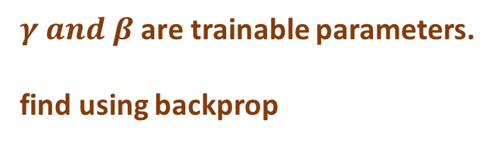
Batch Normalization: How to do?
Normalize distribution of each input feature in each layer across each minibatch to N(0, 1)
Learn the scale and shift
$γ and β$ are trainable parameters.
find using backprop

Slide 6
Batch Normalization: At test time
Distribution does not change with the inputs
Needs to contain information learnt through all training examples
Run a moving average across all mini-batches of the entire training samples (population statistics)

Slide 7
Regularization

Slide 8
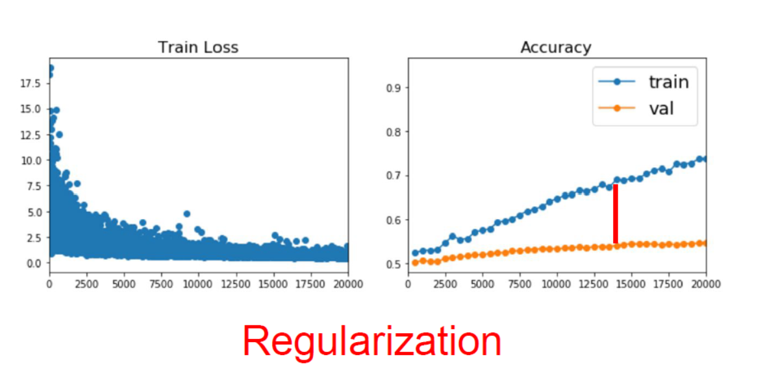
Improving Single Model Performance

Slide 9
Regularization
Key idea
Add a term to the error/loss function

Slide 10
Regularization
Key idea
Add a term to the error/loss function

Slide 11
Regularization
Key idea
Add a term to the error/loss function

Slide 12
Regularization
Key idea
Add a term to the error/loss function

Slide 13
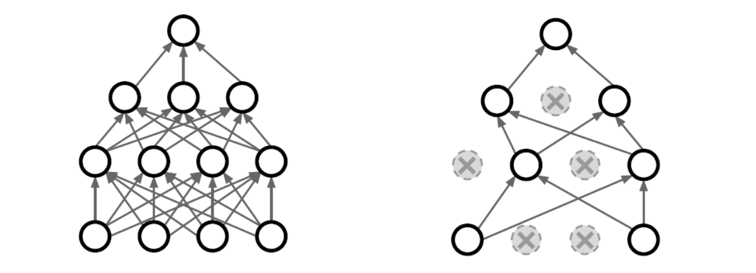
Regularization: Dropout
Key Idea: During training, randomly drop some neurons. Probability of dropping is a hyper-parameter. For example, 0.3.

Slide 14
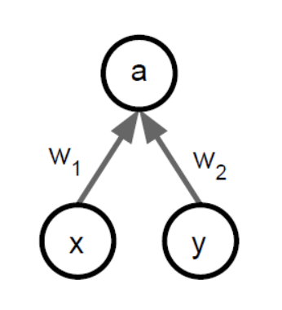
Dropout: Test Time

Slide 15
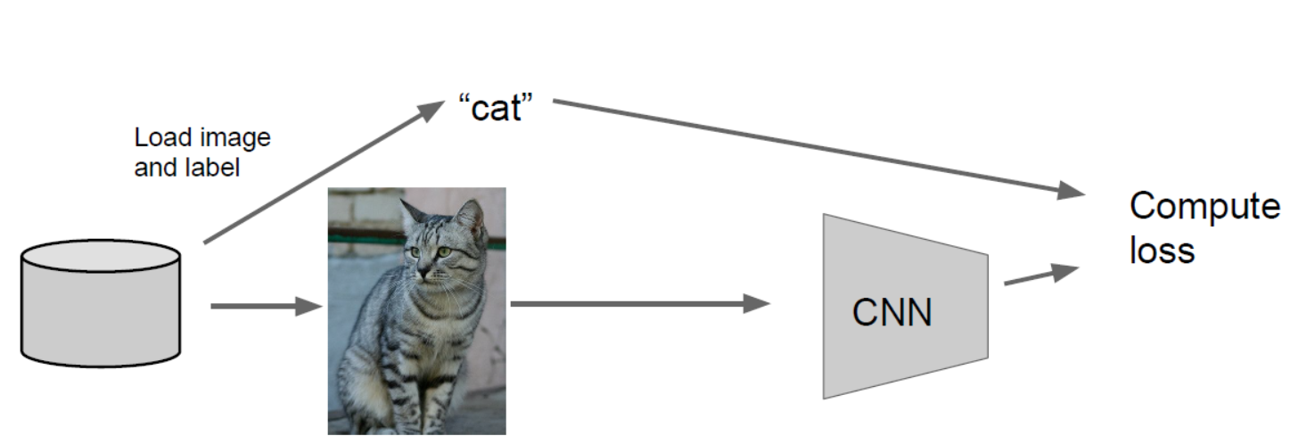
Regularization: Data Augmentation
Source: Fei Fei Li

Slide 16
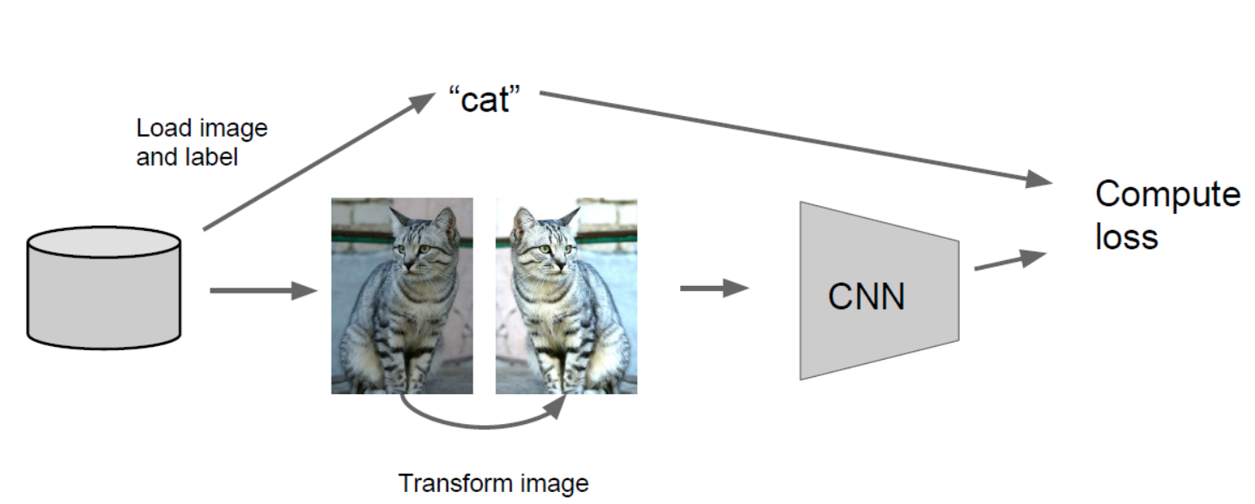
Data Augmentation: Image Transformation
Source: Fei Fei Li

Slide 17
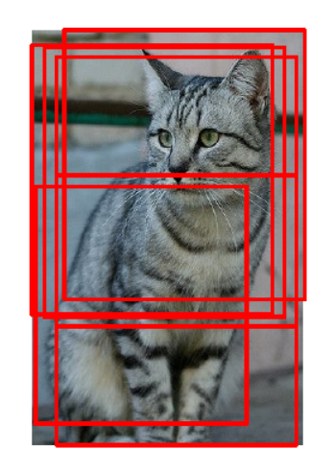
Data Augmentation: Random Crops and Scales
During training add random crops
Resize training images
Sample random patch
Source: Fei Fei Li

Slide 18
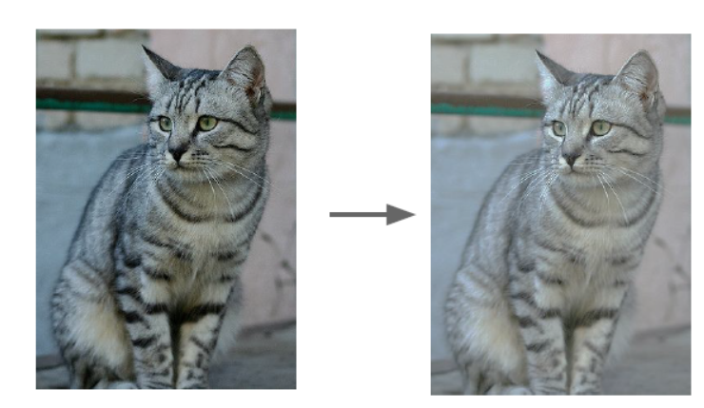
Data Augmentation: Color Changes
Randomize contrast and brightness
Source: Fei Fei Li

